Slide 1
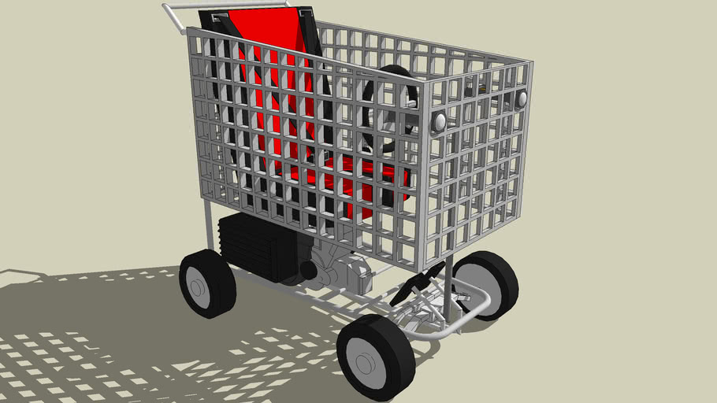

TIRED OF PUSHING SHOPPING CARTS ?
HERE IS THE AUTO-CART 2021.

